Slide 1




Albergo Celide & Spa
Wellness Center

Slide 2
Massagges
Classic Massage” – 25 min / 40 min / 55 min……………………………….....................................€ 45,00/€ 60,00/ € 75,00
Relaxing massage to relieve tension.
“Decontracting Back Massage” – 20 min…………………………...................................…...............€ 50,00
Through specific pressures it gives muscles a normal tone dissolving contractures.
“Draining Legs Massage ” – 45 min………………………………………….............................................…€ 75,00
Help the lymphatic system against swelling and water retention.
“Holistic Massage” - 70 min………………………………………………………...............................................…...€ 95,00
Balancing massage acting not only on the tissue but also on the nervous system. Help
eliminate toxins and psycho-physical and physical trauma.

Slide 3
Body Treatments
“Mental Relaxation Treatment” – 20 min……………………………………..........................................................................................€ 50,00
Effective treatment to relax the cervical area.
“Body Scrub Treatment” – 30 min…………………………………………………….......................................................................................€ 65,00
Superficial exfoliation finalized to renew the skin giving new shine and softness.
“Reiki” – 60 min…………………………………………………………………………………….................................................................................................€ 95,00
Effective natural treatment for physical and emotional realignment.
“Cranio-Sacral Biodynamic” – 70 min……………………………………………….....................................................................................€ 99,00
Bio-natural treatment working on the craniosacral system. Through light contacts it helps to reach
a state of deep relaxation and to relieve emotional and physical problems.

Slide 4
Face Treatments
“COCCOLE” – 25 min……………………………………………………………………………......................................................................€ 45,00
Soft peeling, tonic and decongesting massage
“REFRESHING” - 35 min………………………………………………………………………....................................................................€ 60,00
Tamponage, facial and décolleté calming pack, eye mask and neck-head massage.
“SPECIFIC”– 50 min…………………………………………………………………………….........................................................................€ 85,00
Personalised treatments according to skin types: dry, normal, impure or sensitive.
“SPECIAL EYES” – 50 min……………………………………………………………………....................................................................€ 85,00
Draining treatment, lymphatic drainage massage, mask and special eye treatment.
TREATMENTS SUGGESTED AFTER THE SPA-PATH

Slide 5
Wellness Packages
“DAPHNE” – 30 min…………………………………………………………….........................................................................€ 45,00
Soft exfoliation with application of body lotion.
“NIMPHA” – 40 min ……………………………………………………………........................................................................€ 85,00
Solar plexus area and abdomen massage. Foot wrap with massage.
“GALATEA” – 50 min………………………………………………………….......................................................................€ 95,00
Back decontracting massage, back mud wrap and leg massage.
“APHRODITE” – 90 min ……………………………………………………......................................................................€ 135,00
Body mask and moisturizing facial treatment.
“VENERE” – 80 min……………………………………………………………….....................................................................€ 159,00
Body scrub and mask, facial and body massage.
TREATMENTS SUGGESTED AFTER THE SPA-PATH

Slide 6
Aesthetics
Manicure - 30 min………………………………………………………………………………..............….€ 28,00
Anti-aging hands treatment - 30 min……………………………………………….…..€ 35,00
Pedicure - 50 min………………………………………………………………………………….................€ 49,00
Anti-aging feet treatment - 30 min………………………………………………….……..€ 45,00
Hair Removal
Whole legs € 36,00 - Half legs € 22,00 - Groin € 16,00
Abdomen € 36,00 - Armpits € 16,00 - Back € 36,00 - Arms € 20,00 - Upper lip € 6,00
MORE INFORMATION AVAILABLE AT THE RECEPTION

Slide 7
Albergo Celide & Spa
OUR WELLNESS CENTER IS OPEN EVERY DAY
FROM 4:00 PM TO 8:00 PM EXCEPT SUNDAY
FOR ACCESS TO THE SPA AND FOR MASSAGES OR TREATMENTS ADVANCE RESERVATION IS REQUIRED

Slide 8
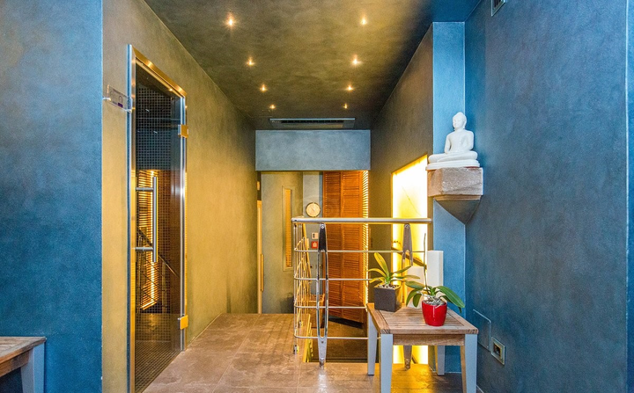
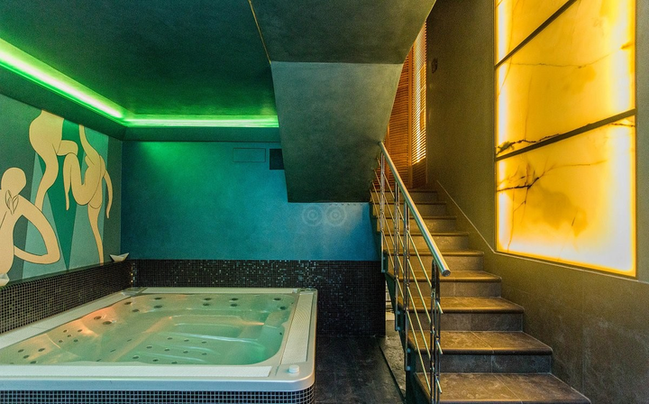
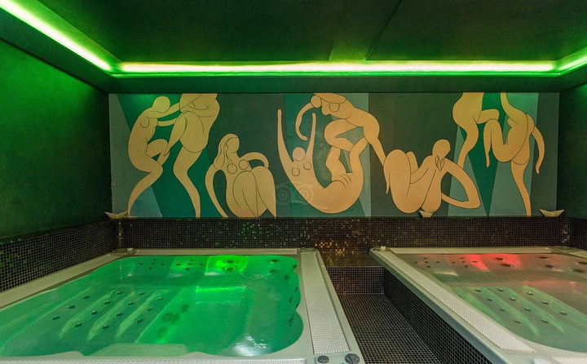
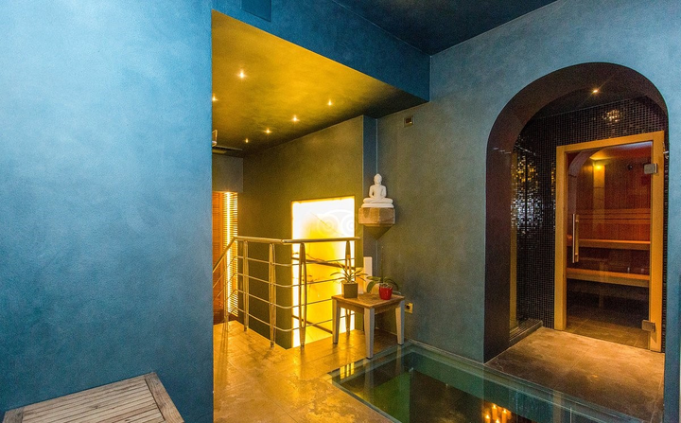
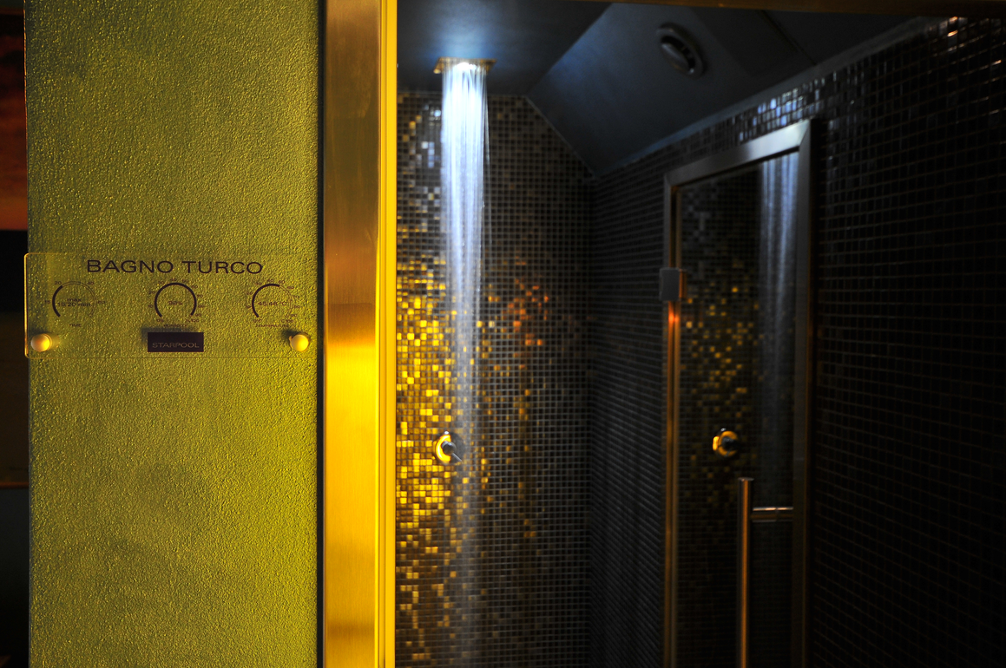
Albergo Celide & Spa

